Slide 1
Azure DevOps
CONFIDENTIAL | © 2020 EPAM Systems, Inc.

Slide 2

Module Overview
Organizations and projects
Azure Boards
Azure Repos
Azure Pipelines

Slide 3
Part 01: Organizations and projects

Slide 4
Organizations and projects Overview
What is organization
What is project
Organization user management
Organization level permissions
Extensions
Pipeline options
Project level user management

Slide 5
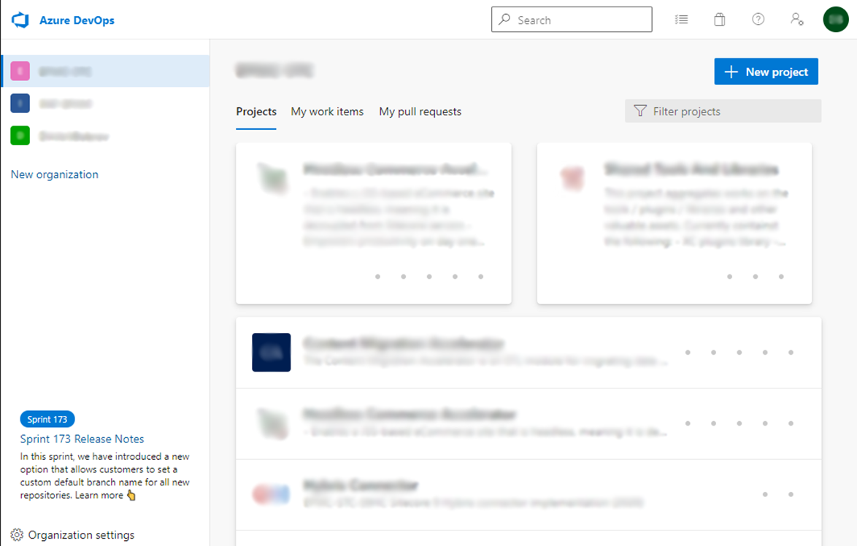
What is organization
Organization is an entity for manage billing, user accounts and global settings.

Slide 6
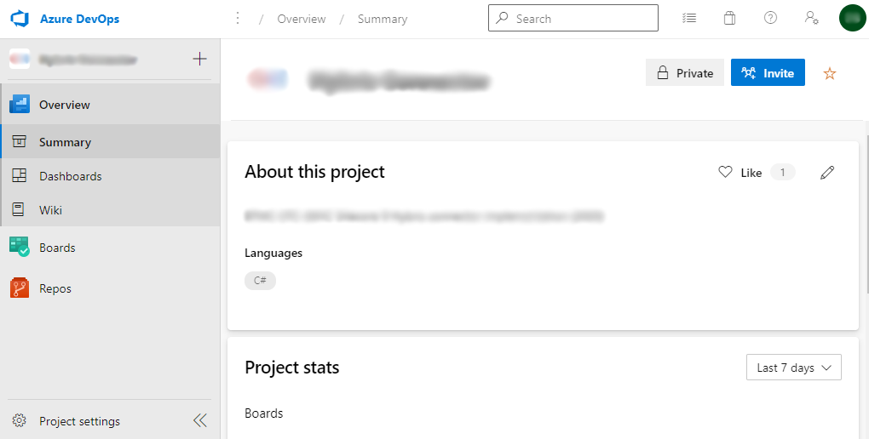
What is project
Project is an entity for technical managing activities in a separate project - wiki, source code, CI/CD processes, etc.

Slide 7
Organization user management
In Users tab of Organization settings must be added people to get access to any project
Access level must be set up to give necessary access in projects
There are 3 built-in access levels: Stakeholder, Basic, Basic + Test Plans
Visual Studio Subscriber access level gives access depending on the type of subscription
Group rules can define which role can be automatically assigned to user in selected project’s user group

Slide 8
Organization level permissions
Here can be configured access rights to whole organization
By default here configured global administrators and service accounts

Slide 9
Extensions
To use extensions in projects it must be installed globally for organization
Marketplace has a lot of useful extension, both paid and free
In practice most common usage of extensions is in configuring boards and processes

Slide 10
Pipeline options
Here can be configured agents for CI and CD and global settings
These options can be configured on a per-project basis, but global parameters can be configured from this location
In Parallel jobs tab you can control usage of free and paid jobs runs

Slide 11
Project level user management
Users are managed using two instruments: Teams and Permissions
Teams used to set different commands, each with own boards, repos, etc.
Permissions used to set access rights for users
Access rights can be assigned per user or per group
Teams can be added in Group to obtain the required privileges

Slide 12
Part 02: Azure Boards

Slide 13
Azure Boards Overview
Project configuration
Iterations
Areas
Team configuration
Iterations and Areas
GitHub connections
Processes
Process configuration
Item Layout
Item States
Item Rules

Slide 14
Project configuration
Most of boards configuration parameters located in Project settings in Boards section
In project configuration you can create Iterations and Areas to be used by teams

Slide 15
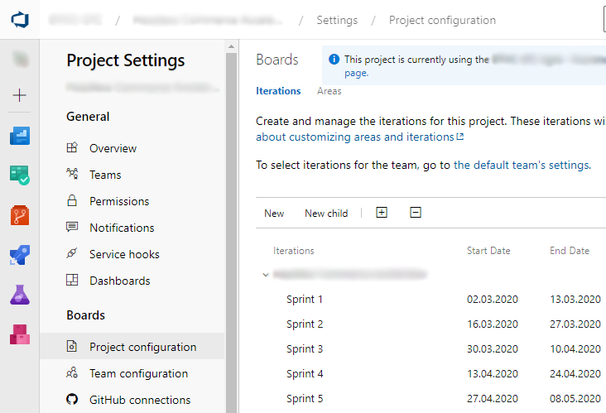
Project Iterations
Iterations is a cycles of development like Sprints in Agile
Only one parent iteration can be configured and it has a name same as the Project
To add different iterations for different teams you need to create parent iterations for them as a child of the main one

Slide 16
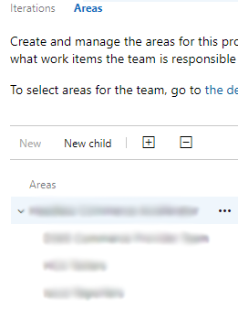
Project Areas
Areas is a groups to determine different backlogs and boards for different Teams
Like with Iterations, only one parent Area can be configured and it has a name same as the Project
To add different Areas for different teams you need to create Areas for them as a child of the main one

Slide 17
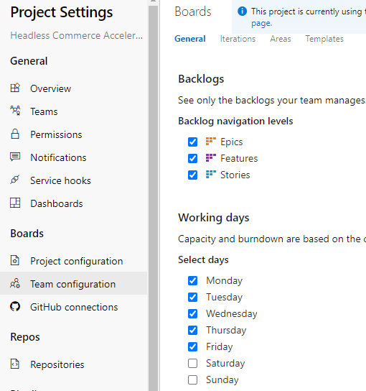
Team configuration
Here can be configured options specific for each team
Team for configuration can be selected in top dropdown menu or from Teams in General section
On General tab can be selected levels for backlog and working days
Templates tab allow to configure default values in each board item for selected Team

Slide 18
Teams Iterations and Areas
On Iterations tab in Teams you can choose iterations for Backlog and default one for selected Team
If you using Scrum, in Default better to leave record “@CurrentIteration” to let it switch automatically
On Areas tab you can choose default Area for selected Team

Slide 19
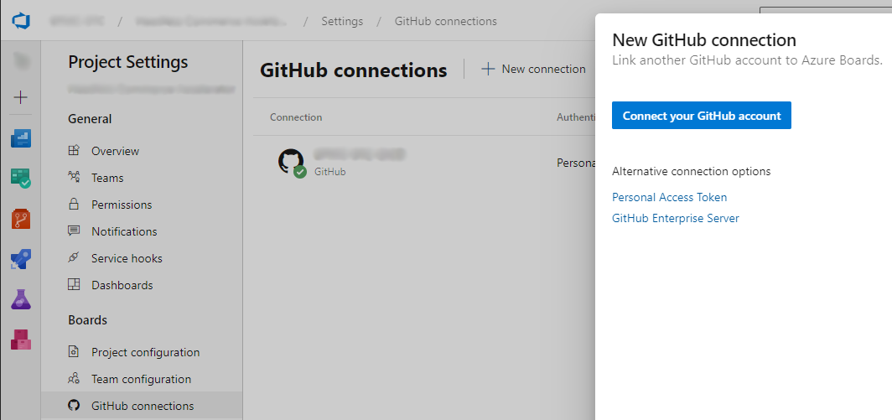
GitHub connections
Here you can add connections with GitHub or GitHub Enterprise Server to use it’s source code and link your Azure DevOps project with GitHub account for CI/CD features

Slide 20
Processes
Processes is a business process for items on boards
Processes management is carried out from Boards section in Organization settings
List of fields for all processes configured globally on Fields tab
On Processes tab you can select one of default process and create your own

Slide 21
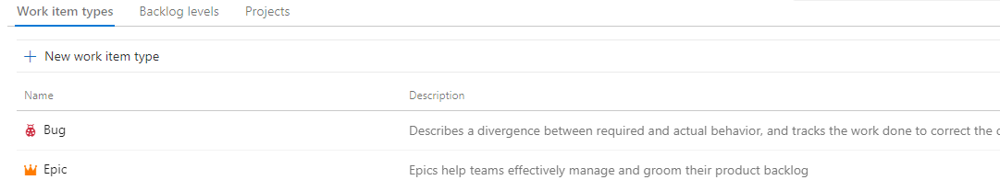
Process configuration
Work item types tab let you to add new item types and configure already existed ones
Backlog levels tab let you to configure item types for different levels of backlog
Projects tab show current Projects assigned to selected process

Slide 22
Item Layout
Here can be configured options specific for each team
Team for configuration can be selected in top dropdown menu or from Teams in General section
On General tab can be selected levels for backlog and working days
Templates tab allow to configure default values in each board item for selected Team

Slide 23
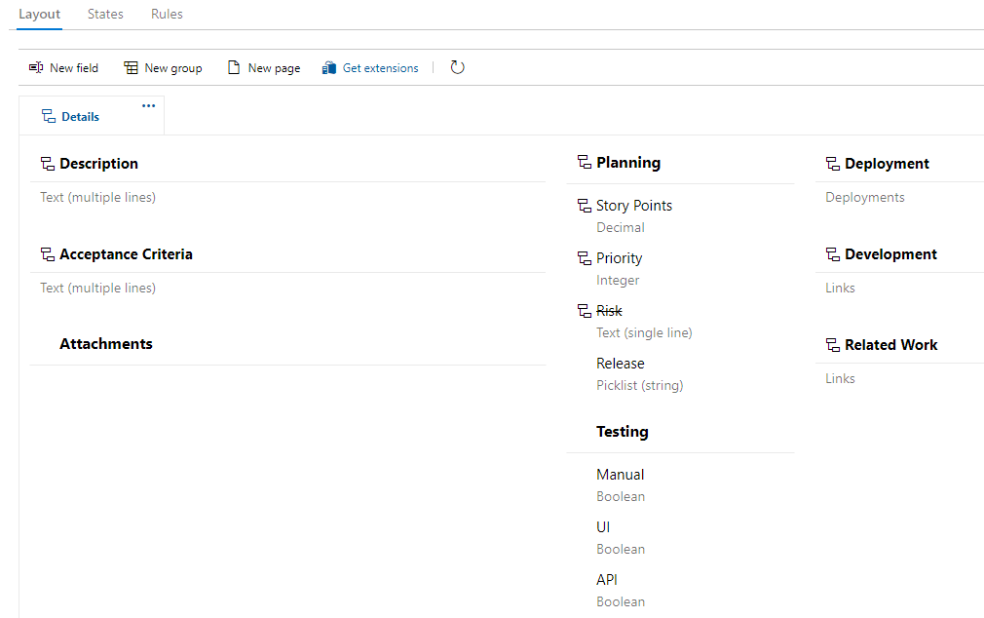
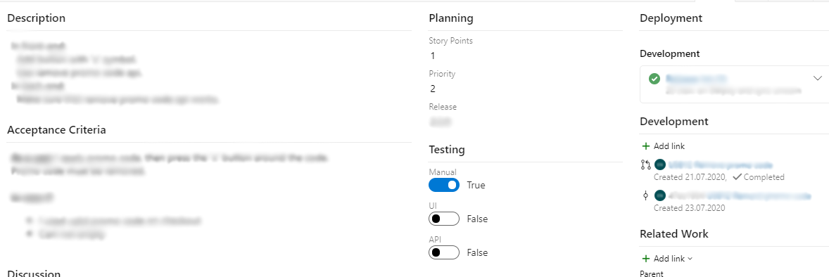
Item Layout
Configuration
How it looks

Slide 24
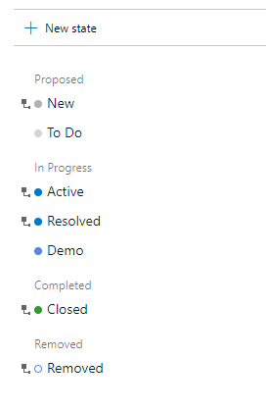
Item States
On States tab you can create new states and configure already existed to make your process on boards
To remove inherited/default states from board you can hide it
Last one in Proposed, In Progress and Completed category cannot be hided/deleted

Slide 25
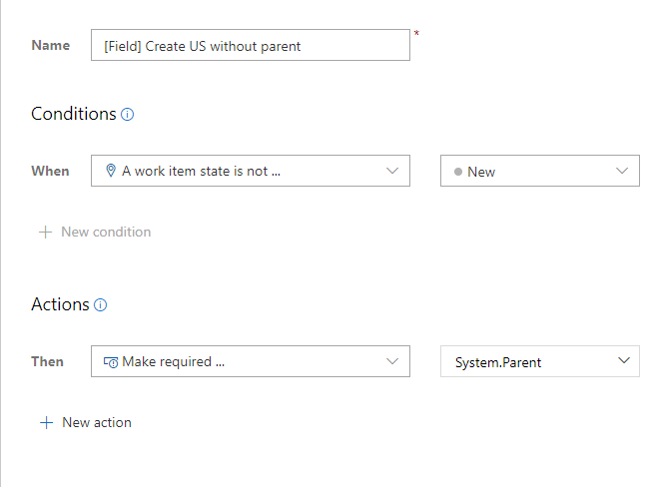
Item Rules
Rules let you configure how item can be moved on the board
Rules can check fields and states of item to allow or deny some actions

Slide 26
Part 03: Azure Repos

Slide 27
Azure Boards Overview
Azure Repos
Repos Permissions
Repos Policies
Branch policies
Build Validation
Status Checks

Slide 28
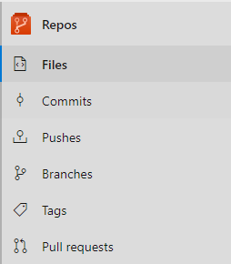
Azure Repos
Azure repos is git repository
It contains standard functionality for git flow similar to GitHub

Slide 29
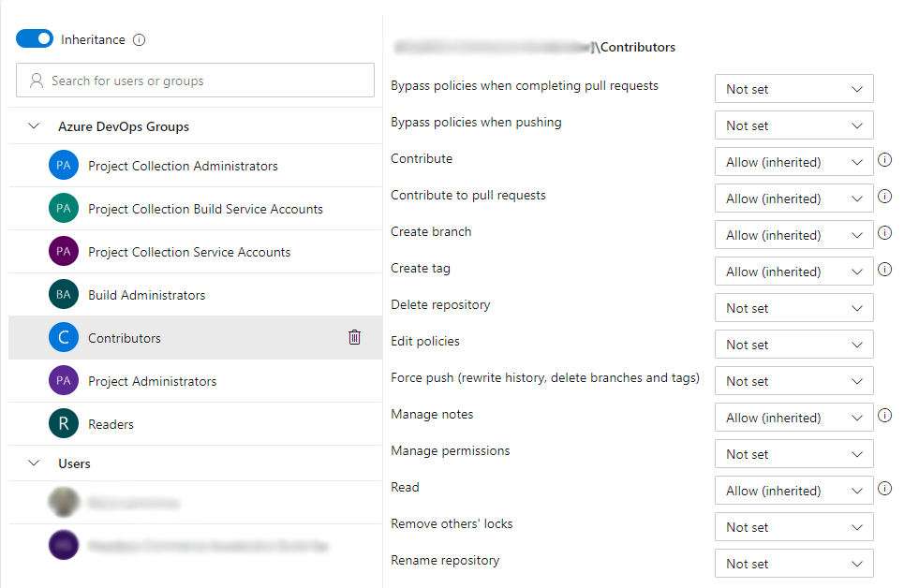
Repos Permissions
Here you can configure permissions for repositories
By default permissions are inherited from Project

Slide 30
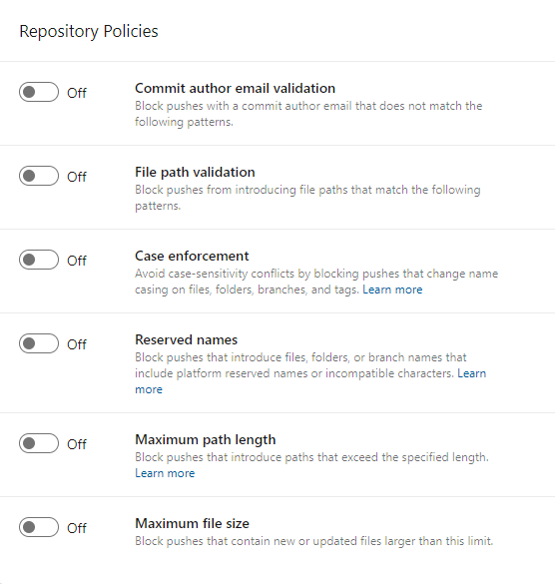
Repos Policies
Here you can set up some policies for all repositories in Project

Slide 31
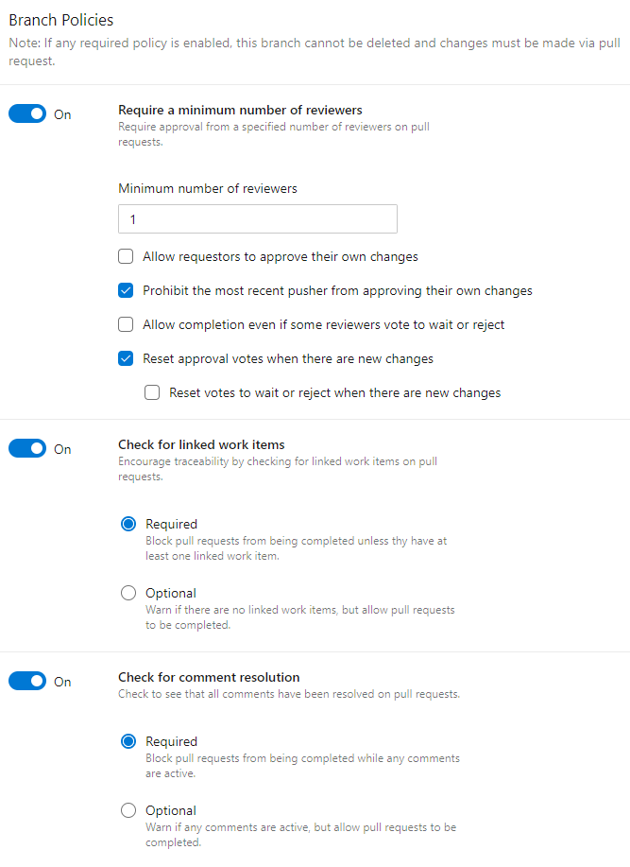
Branch policies
Branch policies is analog for Branch protection in GitHub
Here is a lot of useful options for protect branches like Master, Develop or Release from merging without meeting certain conditions

Slide 32
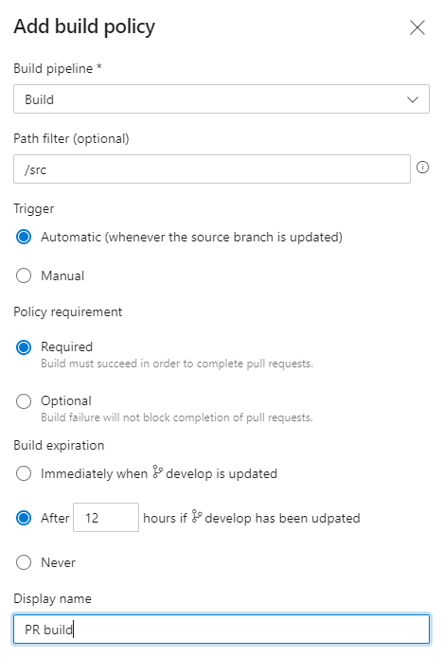
Build Validation
This policy used to run build pipeline for code validation
In “Build pipeline” list located only builds, recently started from this repository

Slide 33
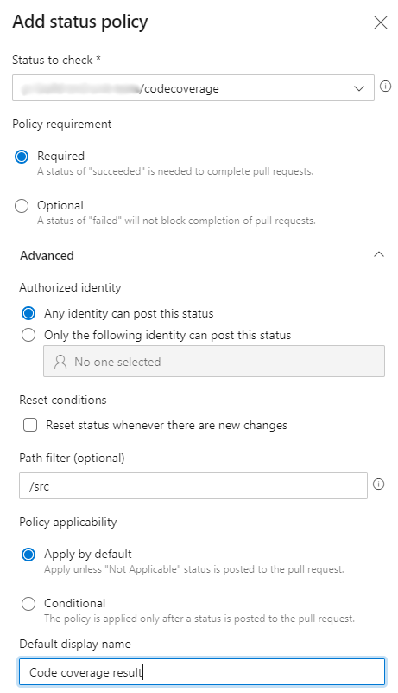
Status Checks
This policy allow to show status of additional checks like code coverage by unit tests or starting up an app
In “Status to check” list located only checks, recently done for this repository
Status check can be manually added by rules listed on information icon from the right

Slide 34
Part 04: Azure Pipelines

Slide 35
Azure Pipelines Overview
Library
Variable groups
Secure files
Pipelines (CI)
Classic editor
Tasks
Steps Editor
Variables
Triggers
Options
Yaml-based pipeline
YAML
Options
Cons and pros
Environments and Deployment Groups
Releases (CD)
Pipeline configuration
CD triggers
Pre-deployment conditions
Post-deployment conditions
Tasks
Variables
Options
Task groups

Slide 36
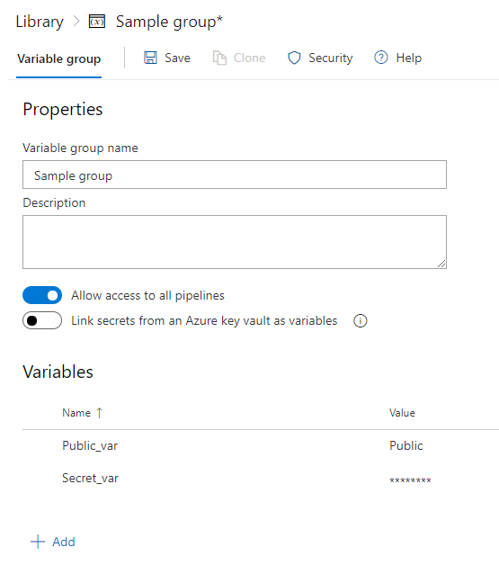
Variable groups
Variable groups can be used to share same variables between different pipelines
There is 2 ways to use it:
Internal storage with variables
Link secrets from Azure key vault
If you need both the secrets from Azure key vault and additional variables there is only way to create 2 different Variable groups and use both

Slide 37
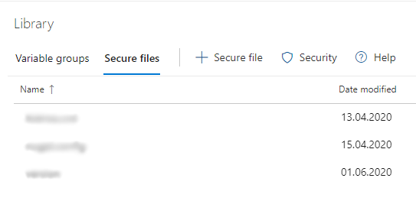
Secure files
Secure files used to place some artifacts that cannot be stored in public artifacts storage (like license files, private keys, etc) between different pipelines
To use secret files in pipelines you need to have permissions to use it and confirm access at first pipeline run

Slide 38
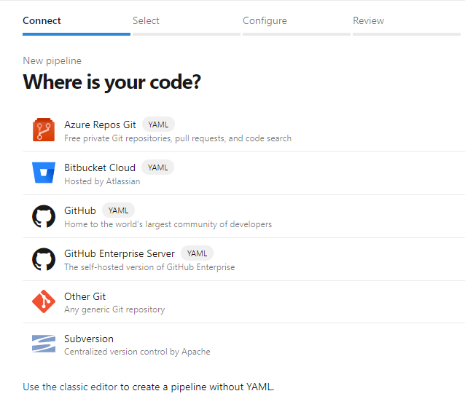
Pipelines (CI)
Pipelines section is a section with CI pipelines
Azure DevOps has 2 ways to create and manage CI pipelines:
Classic editor which looks like building kit
Yaml-based pipelines designed for pipeline as code approach

Slide 39
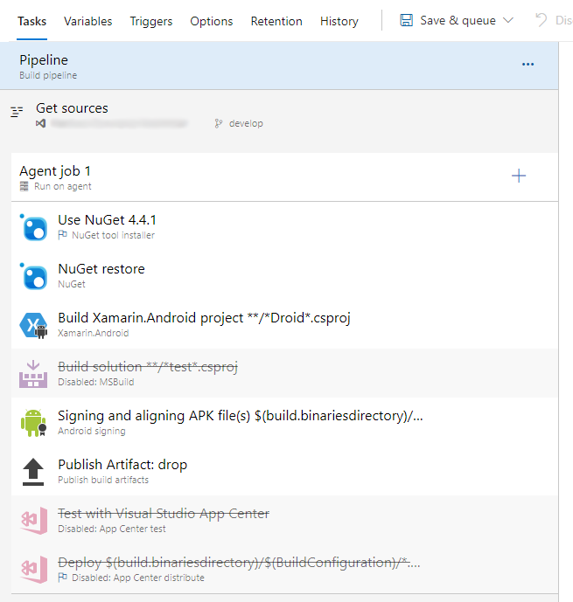
Classic editor
This variant allow to configure pipeline and all of its options in WYSIWYG editor

Slide 40
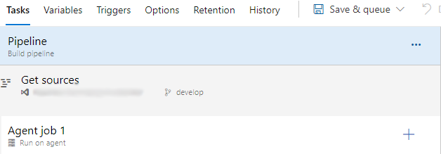
Tasks
In Tasks tab at Pipeline section you can specify global agents selection for all tasks in pipeline
Also here showed global parameter for all tasks. It can be unlinked from here but linked only from variable editor in right task
Here can be changed source of code (repository and default branch)
Here you need to create jobs for chosen agents or agentless jobs (a simple tasks like delays or invokes of some functions)

Slide 41
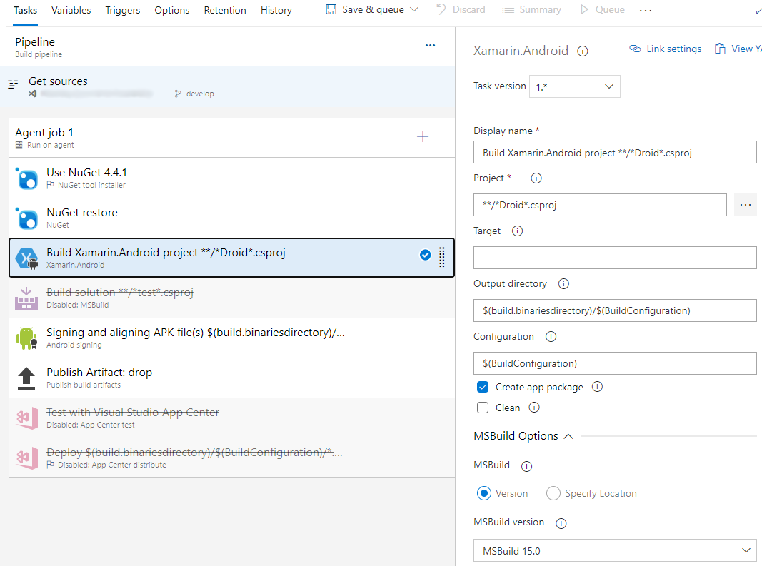
Steps Editor
Main feature of classic editor is editing of pipeline steps in graphical blocks
Each block has different parameters sections to configure specific tasks
Common to all tasks parameters is “Display name” and Control Options to customize task behavior

Slide 42
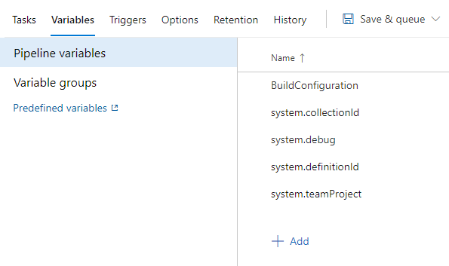
Variables
On Variables tab you can configure variables for pipeline and connect Variable groups from Library
Pipeline variables already have some system variables for pipeline
Also here was always located link to KB with list of predefined variables

Slide 43
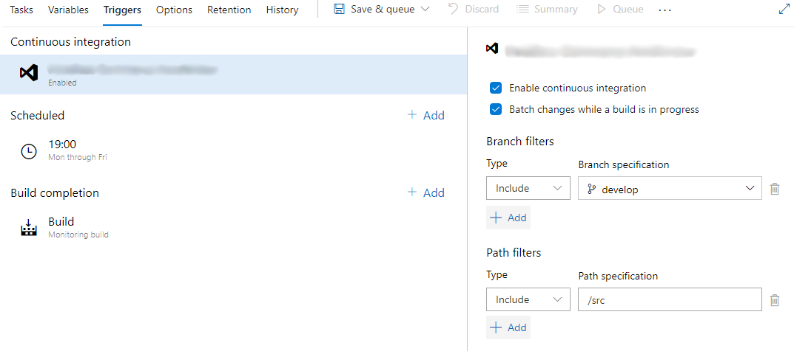
Triggers
Here can be configured triggers for automatic pipeline start:
CI trigger start pipeline after each commit in selected branches (also path filters can be used to run only after changes in specific directories)
Shedule to run pipeline at selected time and days (also can be started only if source code was changed)
Build completion monitors selected pipelines and start this one after selected one

Slide 44
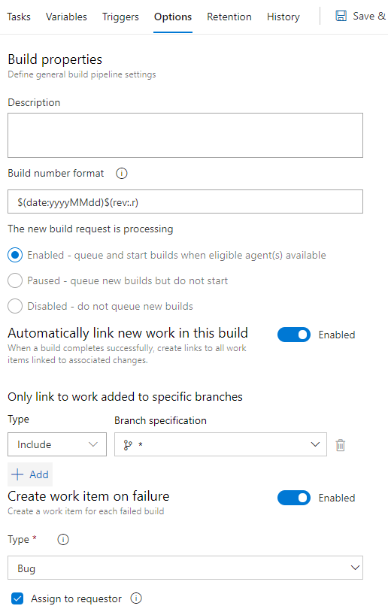
Options
Here can be configured build number format with any variables and static text (each build must use unique number so you cannot use only static text here)
Pipeline can automatically links to all Work items in Boards which linked with source code of this pipeline
Pipeline can create new item on Board on failure

Slide 45
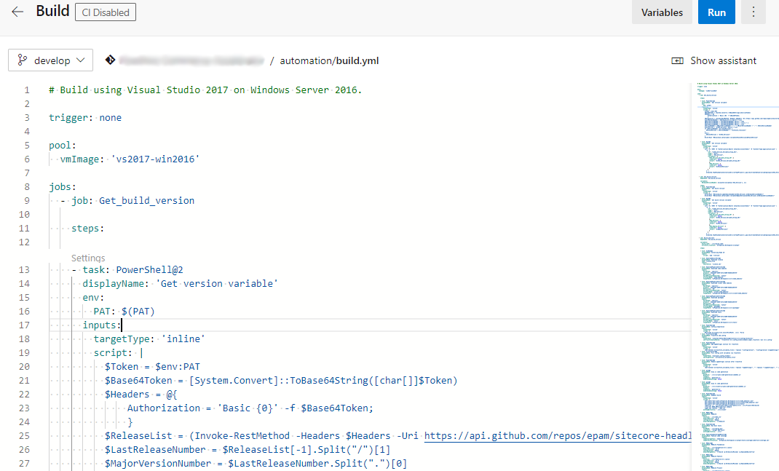
Yaml-based pipeline
This is classic yaml-based pipeline editor similar to Gitlab CI and others CI tools with pipeline as a code approach

Slide 46
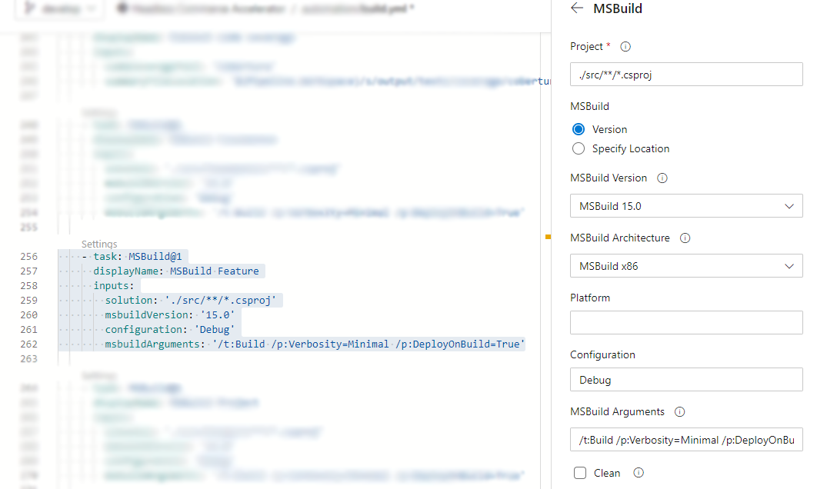
Yaml-based pipeline
You can not write all structure of yaml by yourself but use the assistant to write all service information automatically, concentrating on filling task’s specific information

Slide 47
YAML
To edit pipeline options you need to go to Triggers menu and navigate to YAML tab
Here you can select default agent but it will be use only if agent didn’t specified in yaml
Here can be setup reporting status to source repository

Slide 48
Options
Variables can be configured same as in Classic editor
Triggers works same as in Classic editor and can override configuration from yaml
Build number cannot be configured directly from options and you need to specify build number variable during the pipeline

Slide 49
Cons and pros
Let’s discuss which cons and pros has each of pipeline variants

Slide 50
Environments and Deployment groups
Environments
Deployment groups
Here can be added different environments and filled servers or kubernetes cluster
It is used to control deployments with Azure hosted agents
Similar to Environments here can be added machines
There is less information about deploys
Agent installed on Deployment groups machines and can be use to execute commands on server itself

Slide 51
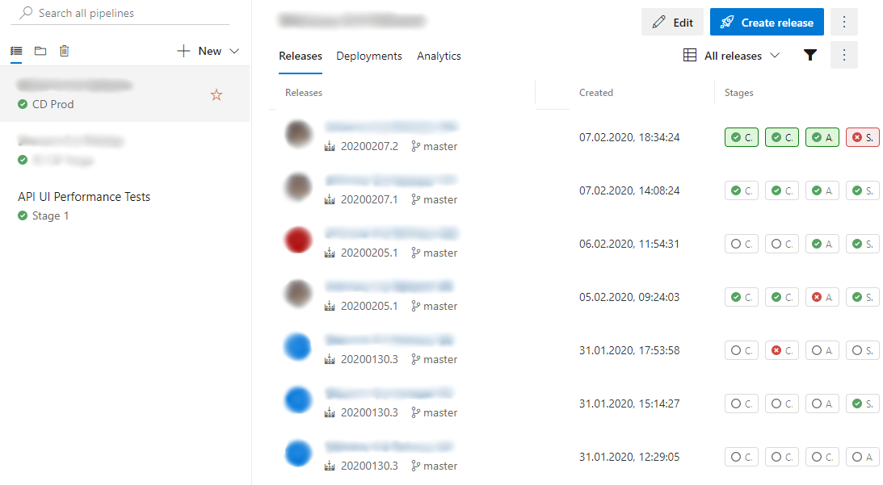
Releases (CD)
Releases section is a section with CD pipelines
CD pipelines can be managed only in classic editor

Slide 52
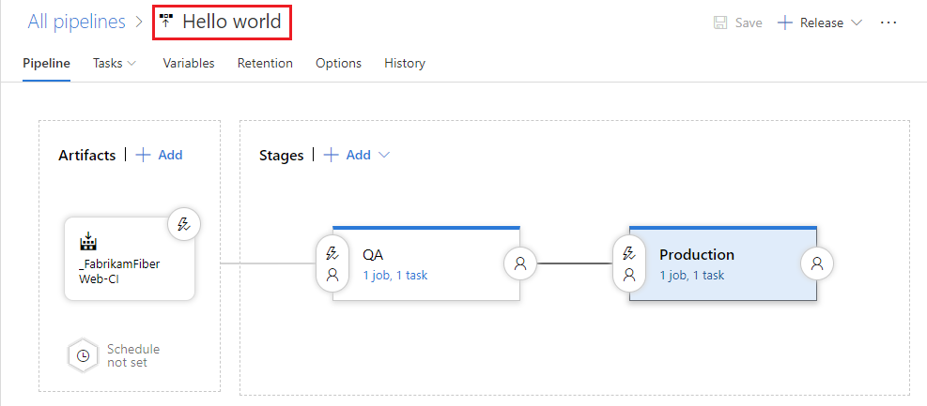
Pipeline configuration
It is constructor kit where you can choose artifacts to use and create stages of CD pipeline
CD pipelines can be managed only in classic editor

Slide 53
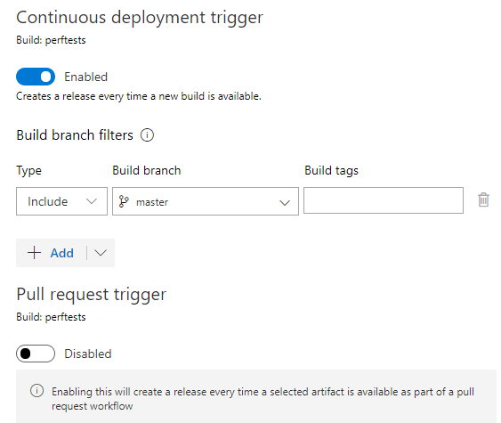
CD triggers
Release pipelines can be triggered by changes in any selected artifact
Releases can be used in pull requests validation
Schedules for releases configuring in Artifacts block like other triggers

Slide 54
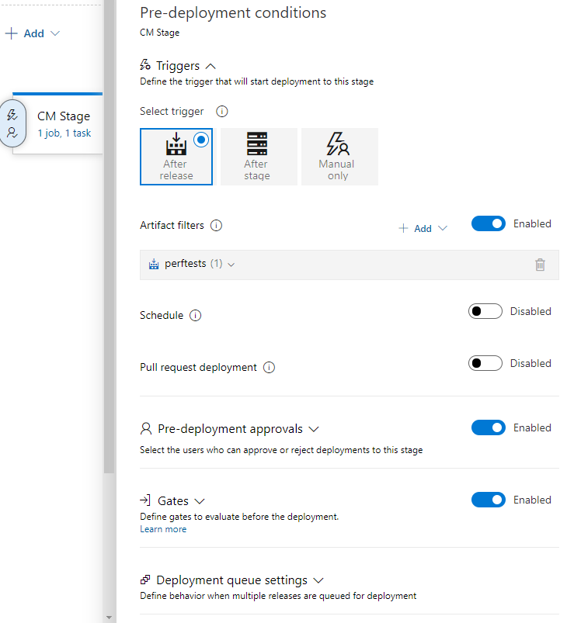
Pre-deployment conditions
For each stage can be selected trigger: after release start, after another stage or manual
Can be selected artifacts to use in each stage
Here can be added users who can approve start of stage
Also here can be configured quality gates to be checked before start

Slide 55
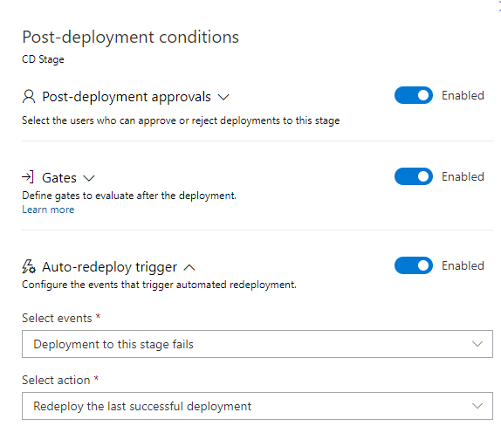
Post-deployment conditions
After each stage can be required approval from some user
Here also can be done some functions as quality gates to verify stage completion
In case of fail here can be configured automatic redeploy previous successful build

Slide 56
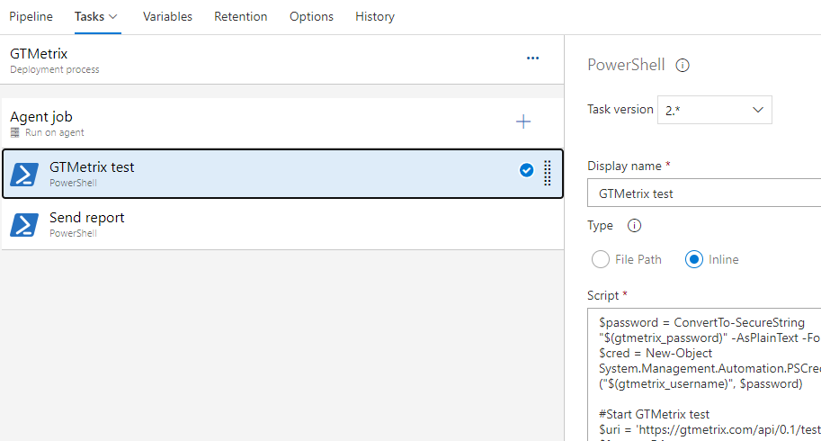
Tasks
For each stage Tasks configured same as in Classic editor for Pipelines
In each stage can be set up multiple jobs on multiple agents and Deployment groups
For every agent job can be configured different artifacts to download and conditions to start

Slide 57
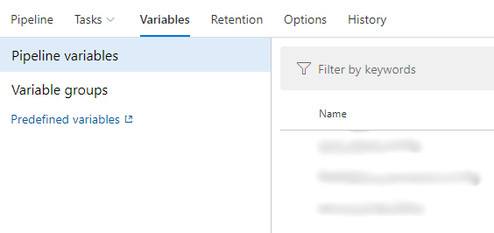
Variables
Variables configuration same as in Pipelines

Slide 58
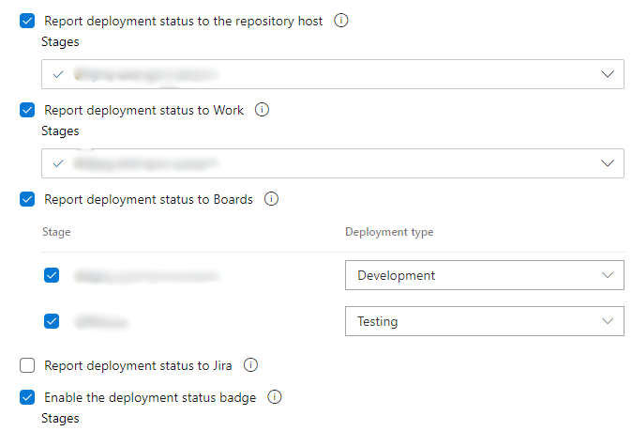
Options
Like in Pipelines, here can be configured build number format with any variables and static text (each build must use unique number so you cannot use only static text here)
Release can report status to repository, Boards (linked items), Jira

Slide 59
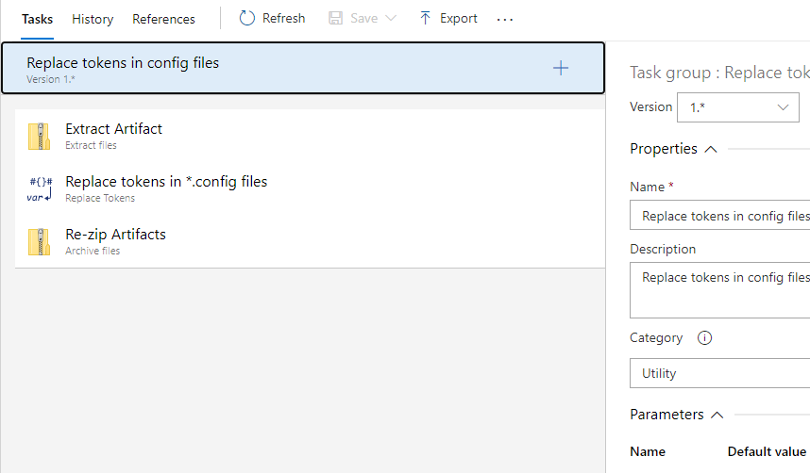
Task groups
Task groups configuring like Pipelines in Classic editor
It used as functions in programming languages – groups of tasks that can be called from pipelines to not configure it separately each time

